Slide 1
Interpersonal Theory Project Analysis
Institution
Professor
Student
Date

Slide 2
Song lyrics
The artist uses the lyrics poetry in a song to express ideas and emotions to the listener.
The listening theory of communication is expressed by the audience who pay attention to understand the song lyrics and the meaning of the message.
“God’s Plan” by Drake, explores the listening theories in the listener and, the artist is likely to influence the listener through the message in the song lyrics.

Slide 3
Movies
Interpersonal communication can also be observed in the relationship of characters in a movie.
“Mrs. Doubtfire” is an American comedy film that uses interpersonal communication in the first scenes to indicate relationship deterioration between the characters.
Daniel decides to throw a birthday party for his son without the consent of his wife which makes her unhappy.
This scene indicates the deterioration of the relationship between Daniel and his wife, Miranda.

Slide 4
Artwork and photographs
Artwork and photographs can be used to communicate without relying on words. They express religious ideas, politics, or convey deep personal thoughts.
Artists prefer to use an image of a celebrity or use a certain color composition to help the people understand the message behind the portrait.
The famous portrait of the former U.S. President Bill Clinton shows the President standing alongside a mantel in the office, which is a symbol of the Monica Lewinsky scandal that happened during the 1990s.

Slide 5
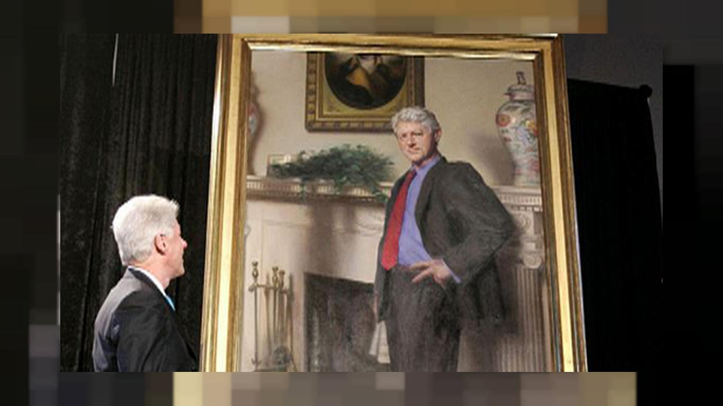
Monica Lewinsky Scandal-portrait

Slide 6
Nonverbal symbols
People can effectively share their ideas and feelings with others without uttering a single word.
Facial expressions display a wide range of emotions during interpersonal communication, such as smiling or frowning.
Verbal communication highly depends on eye contact between the people communicating, to show confidence and engagement in communication.
The body gestures and movements are also essential nonverbal symbols used in interpersonal communication, such as shrug of shoulders or finger pointing.

Slide 7
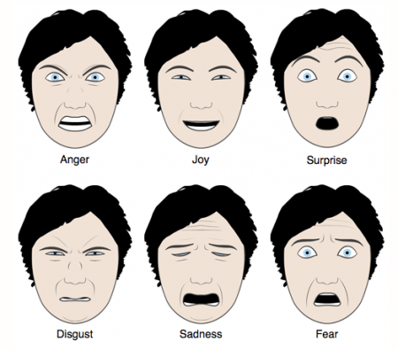
Non-verbal cues

Slide 8
Poetry
Poetry is also an important element used to explore interpersonal theories in writing where poets communicate their emotions and ideas through the poem.
For instance, the poem “Still I Rise” by Maya Angelou is written with the theme of confidence and self-respect. The poet reveals that she will rise up despite any challenges she might face.
The poet uses the writing skills of interpersonal communication to ensure the reader gets the message that she intends to pass through.

Slide 9
Conclusion
Interpersonal communication can be expressed through verbal and nonverbal communication, written communication, and listening skills. The use of various elements of communication such as photographs, poems, and song lyrics is significant in demonstrating the emotions and intentions to the other people, and a perfect way of exchanging ideas and perspectives. Therefore, development of perfect interpersonal communication skills is vital for effective communication.

Slide 10
References
Barseli, M., Sembiring, K., Ifdil, I., & Fitria, L. (2019). The concept of student interpersonal communication. JPPI (Jurnal Penelitian Pendidikan Indonesia), 4(2), 129-134.
Tiferes, J., Hussein, A. A., Bisantz, A., Higginbotham, D. J., Sharif, M., Kozlowski, J., ... & Guru, K. (2019). Are gestures worth a thousand words? Verbal and nonverbal communication during robot-assisted surgery. Applied ergonomics, 78, 251-262.
Zuhro, L. (2018). Gender Stereotypes in The Five Year Engagement Movie. Pioneer, 10(2), 318702.

